Slide 1

Canadian National Consortium of the International Center for Academic Integrity
ICAI Canada
March 2023
Presentation to Canadian Consortium

Slide 2
Land Acknowledgement
The location we are meeting from today is the ancestral territory of the Miami, Potawatomi, and Shawnee people. It is important for us to acknowledge and thank these original custodians of this land. This land acknowledgement is intended to be a sign of respect to all those who went before us.

Slide 3
Purpose & Goals
Purpose
ICAI Canada is bilingual (English and French) and serves as an education and best practice resource for Canadian universities and colleges working to create cultures of integrity.
ICAI Canada’s goals are:
Develop and offer education and professional development opportunities to local practitioners;
Support practitioner day-to-day efforts at their own institutions;
Disseminate best practices from the international and national to the region;
Provide academic integrity resources, including links to the ICAI; and
Introduce regional universities and colleges to the work and benefits of ICAI.

Slide 4
Inaugural Executive
Chair – Jennie Miron (Ontario - Humber College ITAL) jennie.miron@humber.ca
Vice-Chair – Angela Clark (Ontario - York University) angclark@yorku.ca
Secretary – Leanne Morrow (Alberta - University of Calgary) lhlmorro@ucalgary.ca
Event Coordinator – Allyson Miller (Ontario -Toronto Metropolitan University) allyson.miller@ryerson.ca
Communication Coordinator – Rachel Gorjup (Ontario – U of T) rachel.gorjup@utoronto.ca

Slide 5

Our Goal

Slide 6
Advisors
Other Advisory Committee members are appointed, and may have specific responsibilities assigned, or hold their appointment based on special interests, experience/knowledge, defined strategies, or groups (e.g., provincial AI network, K-12 Liaison).
Advisors
British Columbia –Ainsley Rouse (Senior Manager Academic Integrity – UBC ainsley.rouse@ubc.ca )
Alberta -- VACANT
Saskatchewan – Susan Bens (Education Development Specialist – University of Saskatchewan susan.bens@usask.ca)
Manitoba - Josh Seeland (Manager Library Services Assiniboine Community College seelandjl@Assiniboine.net)
Ontario – Laura Facciolo (Learning Innovation Specialist – York University faccioll@yorku.ca )
Quebec – Martine Peters (Professor Department of Education Sciences -- Université du Québec en Outaouais martine.peters@uqo.ca )
New Brunswick – Cynthia Potvin (Associate Professor, Department of Translation and Languages – Université de Moncton cynthia.potvin@umoncton.ca)
Nova Scotia—Bob Mann (Manager, Discipline and Appeals, Dalhousie University bob.mann@dal.ca
PEI – Paul MacLeod (Sessional instructor at UPEI, Director, PACT Consulting Group – dr.paulmacleod@gmail.com )
Newfoundland & Labrador—VACANT - message sent to Memorial
Yukon—VACANT - message sent to President Yukon University – Dr. Brown
Northwest Territories– VACANT - message sent to Aurora College
Nunavut—VACANT - message sent to Nunavut Arctic Circle – President Becky Mearns

Slide 7
QUESTIONS - COMMENTS

Slide 8
Updates from the Provinces
Academic Integrity Update from Provinces/Territories
BC (Ainsley Rouse)
Alberta (Leeanne Morrow)
Saskatchewan (Susan Bens)
Manitoba (Josh Seeland)
Ontario (Jennie Miron)
Quebec (Martine Peters)
Eastern Provinces (Bob Mann)

Slide 9

BC Academic Integrity Network (BC-AIN)
Mission Statement: The British Columbia Academic Integrity Network (BCAIN) facilitates resource sharing and communication that inspire best practices in academic integrity to advance scholarship and professionalism.
The BC-AIN meets regularly (bi-monthly) to discuss current events, share best practices and plan BC AI Day.
BC Academic Integrity Day (yearly, in October)
BC AI Day is held yearly, usually the week prior to Academic Integrity Week, to bring together scholars and practitioners in BC. In 2022, the event took place in person at Langara College and consisted in a keynote, panels and resource sharing.
Academic Integrity Week
The BCAIN will be promoting Academic Integrity Week in October through institutions in the network.
Academic Integrity in British Columbia

Slide 10

Academic Integrity in Alberta
Leeanne Morrow

Slide 11

Academic Integrity in Manitoba
Manitoba Academic Integrity Network (MAIN) meets monthly
  2nd year of MAIN Speaker Series
Our annual event is AIIIM (on 7th year now)
Members work on individual or collaborative initiatives at their respective institutions daily
Many members also participate in weekly Integrity Hour online CoP
Members also work together annually at ICAI and during Integrity Week in October

Slide 12

Academic Integrity in Saskatchewan
Provincial Academic Integrity Community of Practice
  Established in 2021 by co-leads Ann Liang (USask) and Tasha Maddison (SaskPoly). Meet 4-6 times/year, the group may invite a presenter to lead discussion around a certain topic - other times opens discussion for the topics of shared interest
  Members report increased concern related to misuse of new technologies and services for academic misconduct and interest in educative approaches that support academic integrity
Regional College System
  A multiple institution and distributed campus system, some report the shift to more online and virtual assessments have presented new academic misconduct concerns.
  Colleges that broker courses for other institutions must also attend to the regulations of the home institution and what serves as sufficient evidences of academic misconduct.
SaskPolytechnic
  A single institution with multiple campuses, an institutional committee for academic integrity monitors trends and issues and an Academic Integrity Consultant was recently hired as part of Student Services.
  The teaching centre hosts monthly meetings of an Academic Integrity community of practice, in collaboration with library and learning technologies.
Universities
  University of Regina (federated with First Nations University of Canada) joined ICAI as an institutional member, created an “Academic Integrity Hub” website, and is updating policy
  University of Saskatchewan engaged a faculty task force to identify key strategies (report forthcoming), created a new “Integrity Matters” website, and the teaching centre has expanded its professional learning events and resources

Slide 13
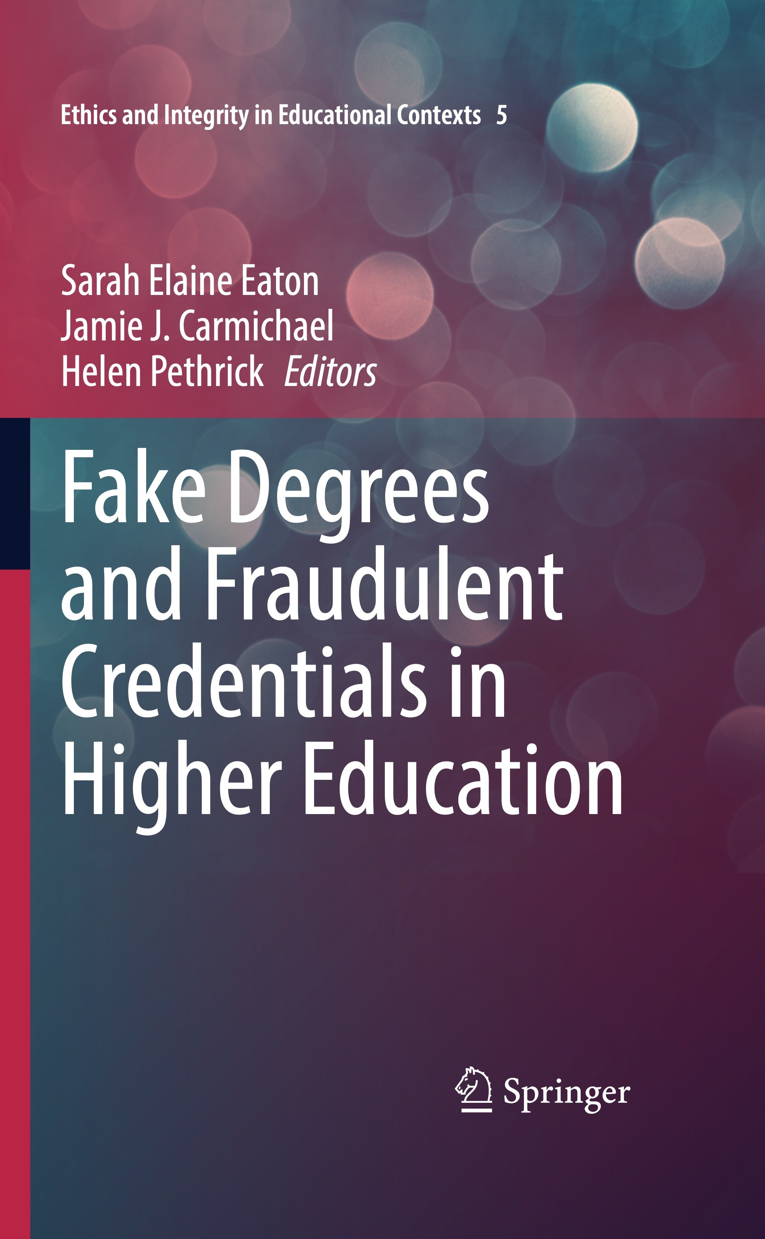

Academic Integrity in Ontario
Fake Degrees and Fraudulent Credentials in Higher Education-Jamie Carmichael & Sarah Eaton
Global information about fake degrees, diploma mills, admissions fraud, cheating on standardized tests
discusses how to stop the proliferation of this industry
Algonquin College is currently doing a faculty survey focused on artificial intelligence (use in teaching practices) Sandra Larwill (larwills@algonquincollege.com )
  AICO
  Work Group created a sheet for faculty about artificial intelligence & academic integrity (Creative Commons License)
  Academic Integrity Hours continue with participation between 20-30 people
  Looking at revising terms of reference – work will be completed in spring
  New executive taking over in spring
  Conestoga College
conducted an all-faculty survey (N=989) 40% response rate
first focus will be on barriers faculty experience & the impact of emotions while navigating academic integrity violations.

Slide 14

Academic Integrity Québec
Martine Peters

Slide 15

Academic Integrity in Nova Scotia
Brian Hotson, in affiliation with our Dalhousie University’s Faculty of Open Learning and Career development, has been managing a project to build a curriculum took for faculty members to help better approach the challenge of academic integrity issues involving international students. We are currently at the internal data-collection stage of this project, which involves surveys and focus groups.
Dalhousie will be holding a round-table on ChatGPT in March.
Academics and administrators from Nova Scotia participated in a symposium on contract cheating hosted by St. Mary’s University in May 2022.

Slide 16
Small Group Discussions (Regions/Provinces)
Opportunity to have discussion with colleagues about common interests, best practices, new challenges………..

Slide 17
Break

Slide 18
Transition to Back In-Person Teaching & Learning
Moderator Leanne Morrow
Guest Speakers
Elaine Khoo (U of T)
Allyson Miller (TMU)

Slide 19
Lunch -- Networking

Slide 20
Highlighting Canadian Research & Scholarship Activities
Moderator Angela Clark
Guest Speakers
Martine Peters
Allyson Miller
Angela Clark
Emma Thacker (slide)

Slide 21
Thacker, E. J – Recent Research and Chapters https://orcid.org/0000-0001-8357-0399
Recently Published Book Chapter (based on doctoral thesis)
Thacker, E. J. (2022). Assessment Brokering and Collaboration: Ghostwriter and Student Academic Literacies. In: Eaton, S.E., Curtis, G.J., Stoesz, B.M., Clare, J., Rundle, K., Seeland, J. (Eds.) Contract Cheating in Higher Education. Palgrave Macmillan.
https://doi.org/10.1007/978-3-031-12680-2_19
In Press (Chapter) and Submitted Manuscript (research)
Thacker, E. J. (unpublished manuscript). Academic Integrity and the Canadian University Ombudsperson. In Eaton, S. E. (Ed), Handbook of Academic Integrity. Springer.
Thacker, E. J. (in Press). Aspiring to the transformational: Building upon a holistic approach to academic integrity in higher education. In I. Leman Stefanovic (Ed.), Conversations on ethical leadership: Lessons learned from university governance. University of Toronto Press.

Slide 22
Stretch Break (Drinks & Light Snacks)

Slide 23
Small Group Work – Case Studies
Artificial Intelligence & Academic Integrity
Policy Regulation
Supporting Educators
Student Use of Unauthorized Artificial Intelligence
Record on Jamboard – QR Code with minutes

Slide 24
Report Back from Groups

Slide 25
Closing Remarks
Canadian Perspectives on Academic Integrity Journal
About the Journal--Focus and Scope
One objective of this online, open-source journal is to provide Canadian practitioners working in the area of academic integrity with a venue to share experiences and insights about their work. A second (though no less important) goal of this journal is to elevate awareness and mobilize knowledge about issues relating to academic integrity in Canada.
This journal is focused on the Canadian context. Submissions are accepted from those with an e-mail address from a Canadian educational institution. Independent scholars without a Canadian institutional address should contact the editor before submitting a manuscript.
Call for Submissions for Volume 1
2023-02-05
This year marks the 6th of the Canadian Perspectives on Academic Integrity, and we invite Canadian researchers and practitioners engaged in the field of academic integrity to submit articles to be considered for publication in July or December 2023. Included in this year's issues will be the accespted presentation abstracts from the Canadian Symposium on Academic Integrity (CSAI) 2023.

Slide 26
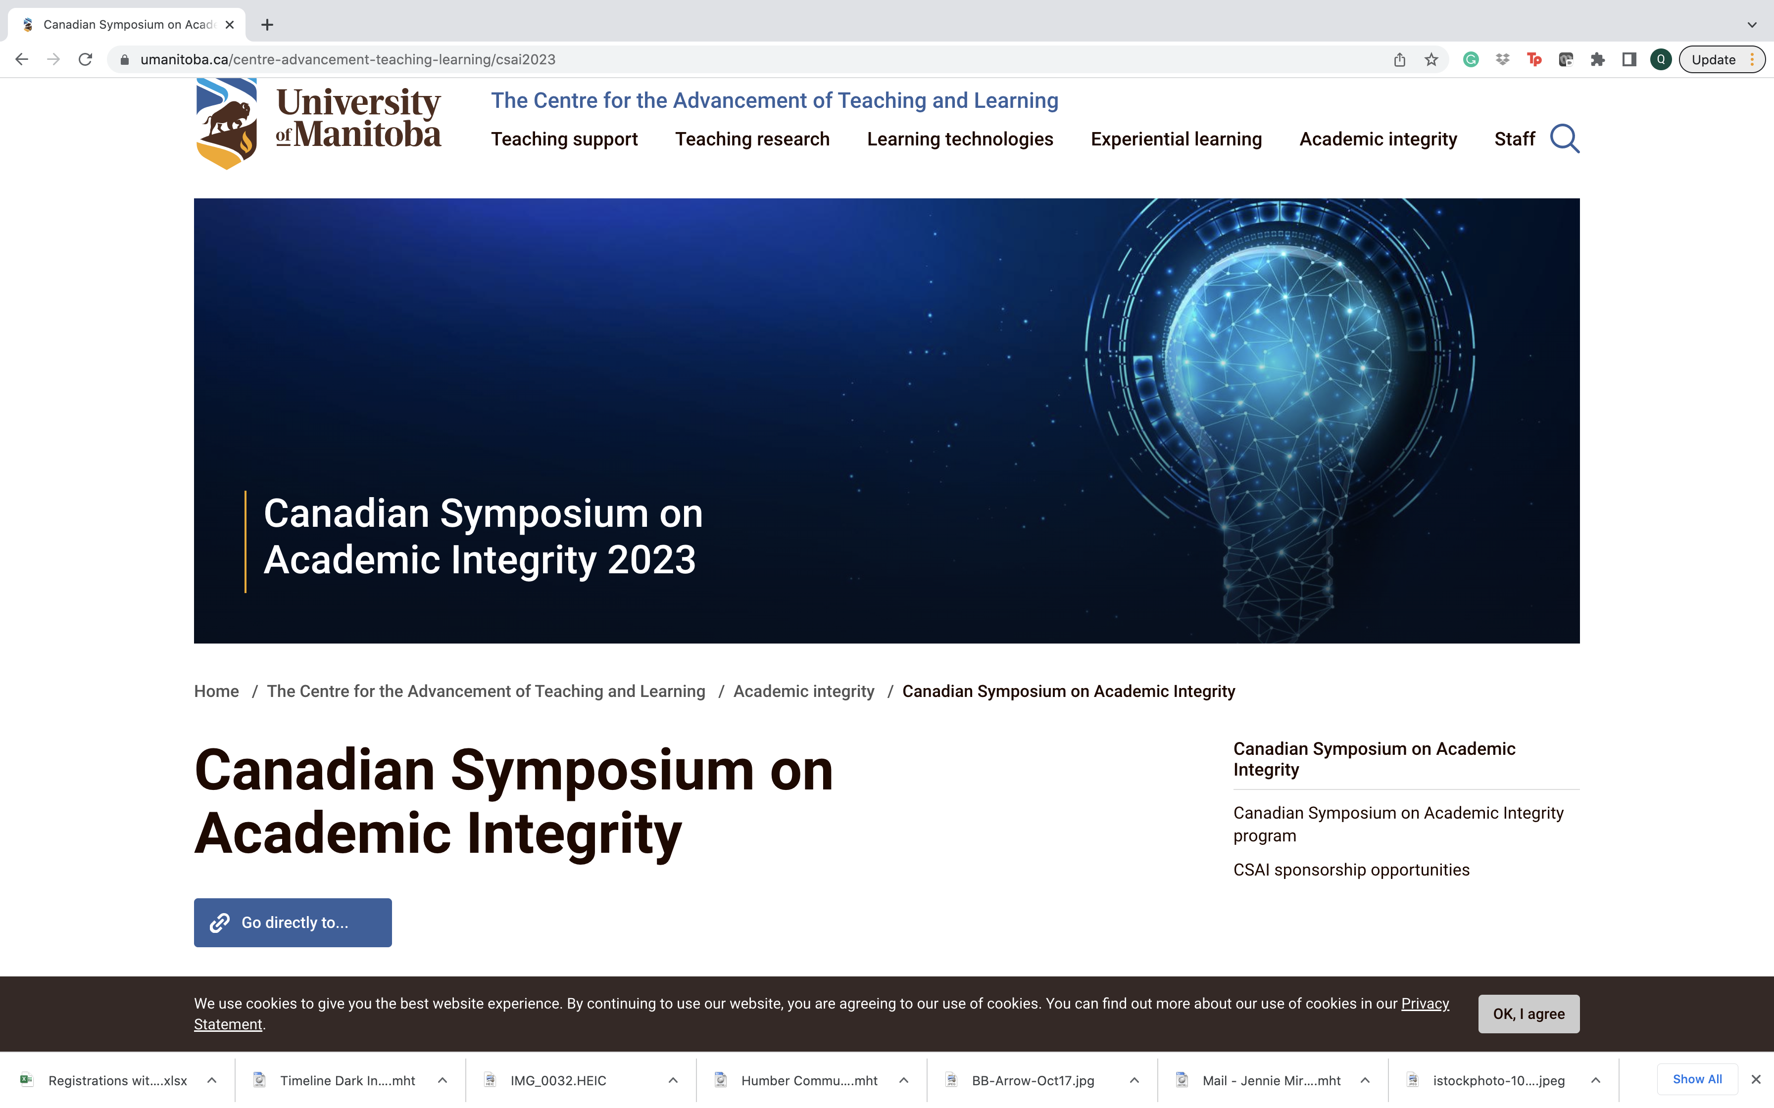
Closing Remarks
June 1-2
Manitoba

Slide 27

Highlights for the Day
What were your highlights for today?
Keep your eyes open for a link that will ask for your feedback – to help us plan for next year.

Slide 28
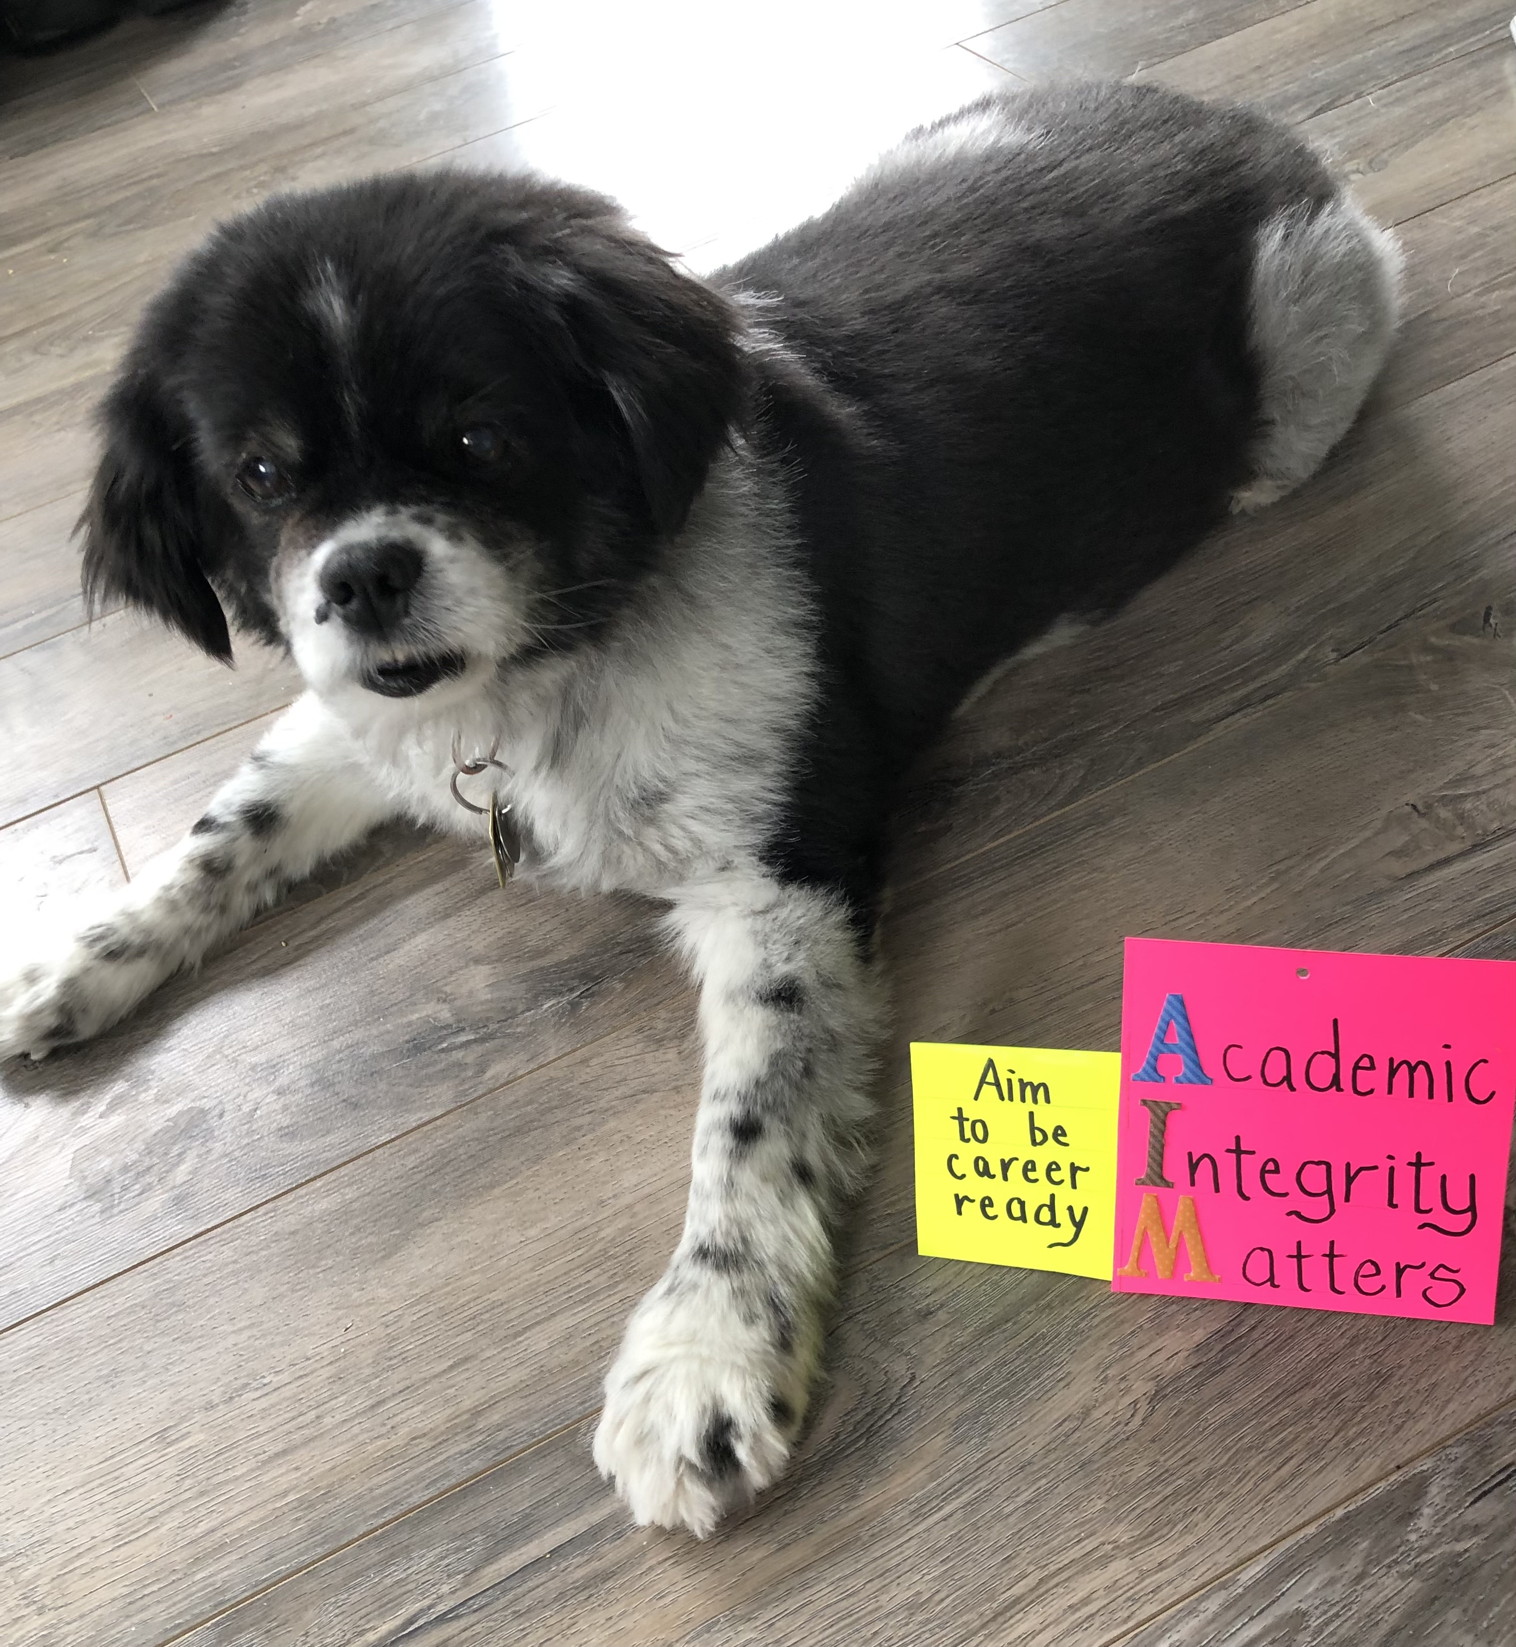
Closing Remarks
Thanks to the planning committee:
Angela Clark (York University)
Sarah Eaton (University of Calgary)
Loie Gervais (University of Manitoba)
Amanda McKenzie (University of Waterloo)
Allyson Miller (Toronto Metropolitan University)
Leeanne Morrow (University of Calgary)
Martine Peters (l'Université du Québec en Outaouais)
Brenda Stoesz (University of Manitoba)
Emma Thacker (University of Toronto)

